Slide 1



NEXT GEN EMPLOYABILITY PROGRAM
Creating a future-ready workforce
STUDENT NAME : LAKSHMI G
STUDENT ID : au820621104032
COLLEGE NAME : ARASU ENGINEERING COLLEGE

Slide 2

CAPSTONE PROJECT
Project Title
Voting Application using Django Framework- LAKSHMI G(4032,AEC)
Abstract | Problem Statement | Project Overview | Proposed Solution | Technology Used | Modelling & Results | Conclusion

Slide 3
ABSTRACT
Django indeed provides a solid and scalable foundation for web applications. Its built-in features like the ORM (Object-Relational Mapping) system, template engine, and built-in admin interface streamline development and maintenance processes. Django's emphasis on security, coupled with its scalability and adaptability, ensures that the online voting application can handle varying levels of user engagement while maintaining the integrity and security of the voting process. Its solid foundation provides developers with the tools needed to create scalable and secure solutions. Django’s combination of features makes its well suited for constructing a reliable, secure, adoptable online voting platform.

Slide 4
PROBLEM STATEMENT
Security and user experience are indeed crucial factors in ensuring the success and trustworthiness of any online voting platform. By leveraging the Django framework, the application can benefit from its robust security features and solid foundation, which are essential for safeguarding the integrity of the voting process.Supporting multiple types of votes, such as single-choice and multiple-choice votes, adds versatility to the application, catering to various voting scenarios and requirements. Moreover, allowing users to set deadlines and restrictions for each vote enhances the flexibility and customization options available within the platform. Overall, by prioritizing both security and user experience, the suggested voting application has the potential to become a trusted and reliable platform for conducting online votes in a variety of settings, whether for organizations, governments, or other entities

Slide 5
PROJECT OVERVIEW
1.Establishing a Django Project:
To provide the framework for the voting application, create a Django project. 2.Creating the Database Schema:
Establish the framework for the database that will hold user data, vote tallies, and
other pertinent information. 3.Establishing User Authentication:
To enable users to sign up, log in, and take part in voting, implement user
authentication. 4.Creating the Voting Interface:
Create the user interface that allows users to browse options, make selections,
and cast ballots. 5.Putting Real-time Results into Practice:
Present the voting results in real-time to give users immediate feedback. 6.Creating an Admin Panel:
To efficiently manage the candidates, user accounts, and voting process, create an
admin panel.

Slide 6
DETAILED SOLUTION
.
Django's scalability and resilience make it a great choice for building such a system. Implement strong encryption protocols to protect user data and prevent unauthorized access. Implement measures such as email verification and CAPTCHA to prevent bots and ensure that only legitimate users can register and participate in the voting process. In conclusion, the Django framework-based voting application that has been suggested offers a safe, adaptable, and user-friendly online voting platform. Its emphasis on security and user experience, along with its use of the Django framework, assures a solid and scalable base, making it an excellent ideal choice for a wide range of voting scenarios.

Slide 7
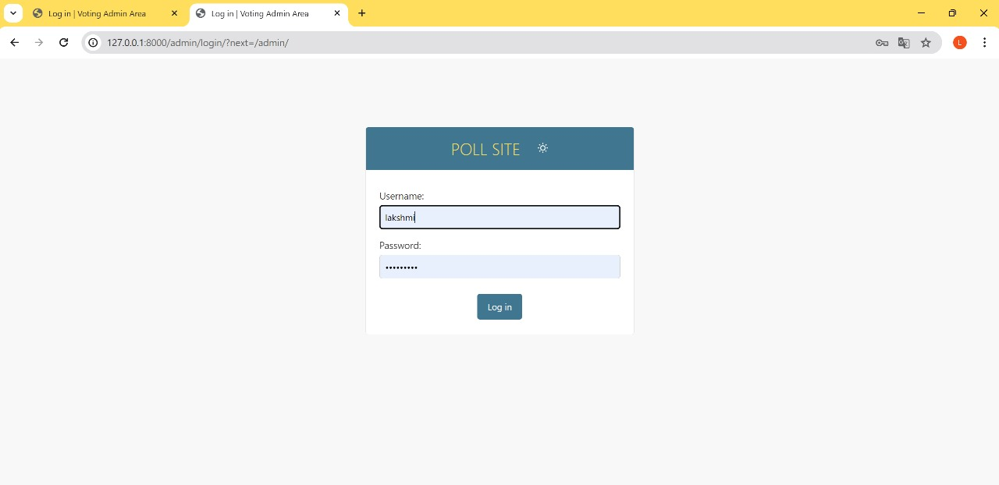

Slide 8
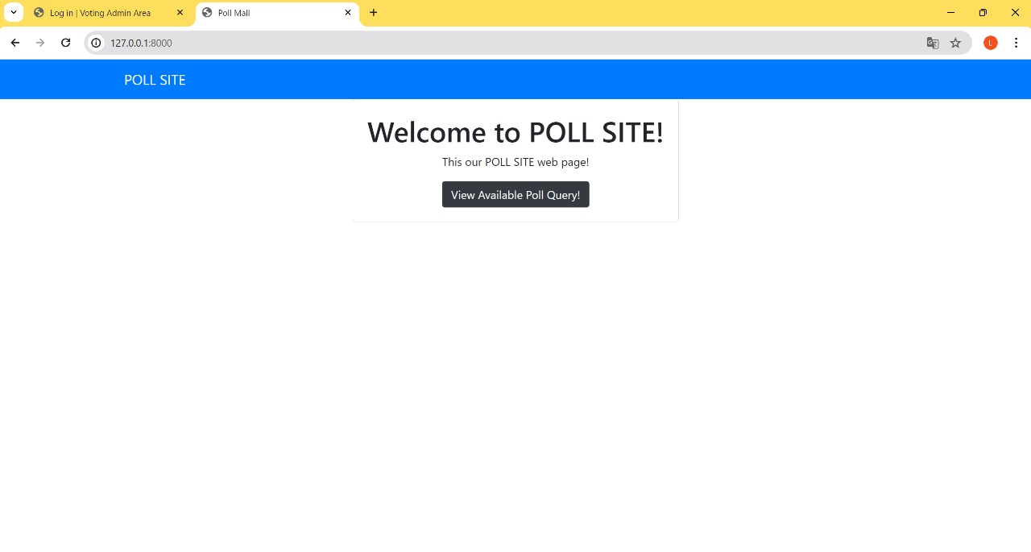

Slide 9
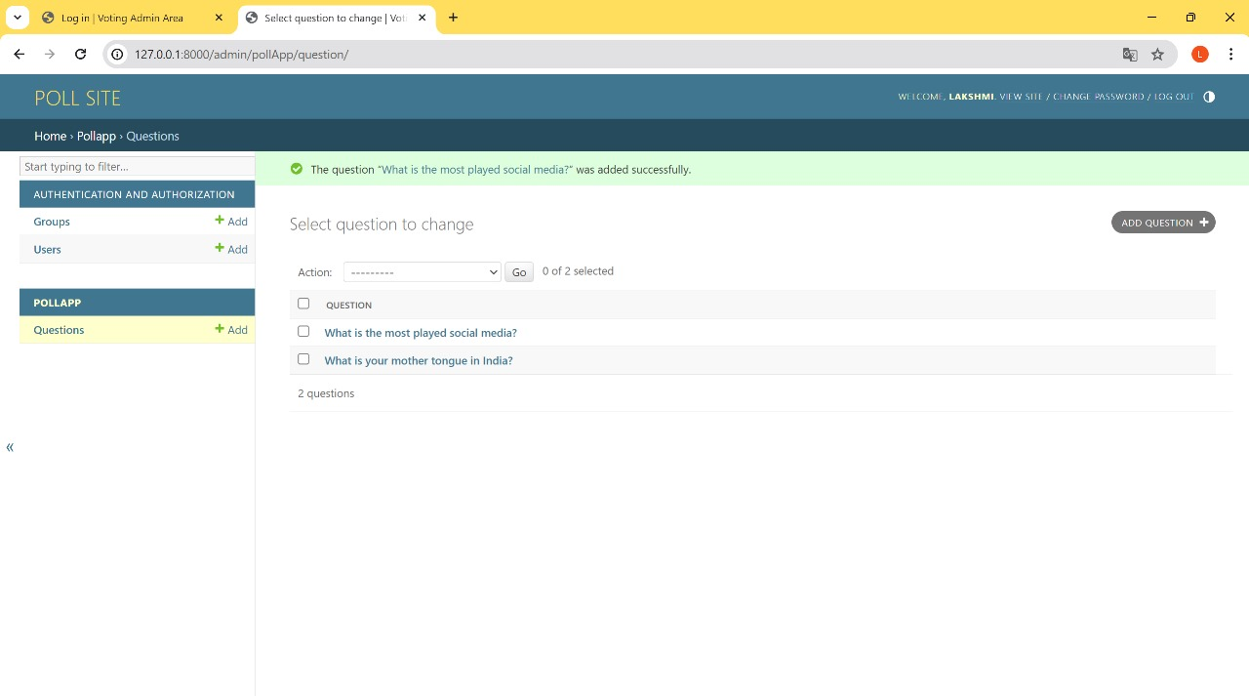

Slide 10
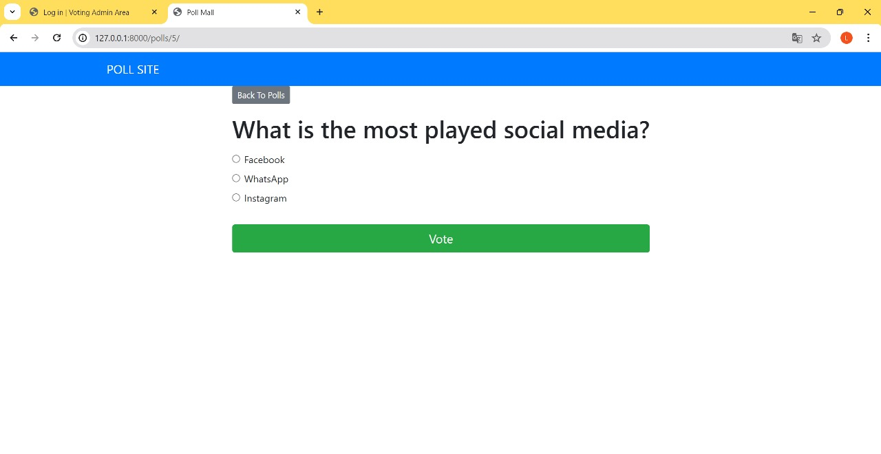

Slide 11
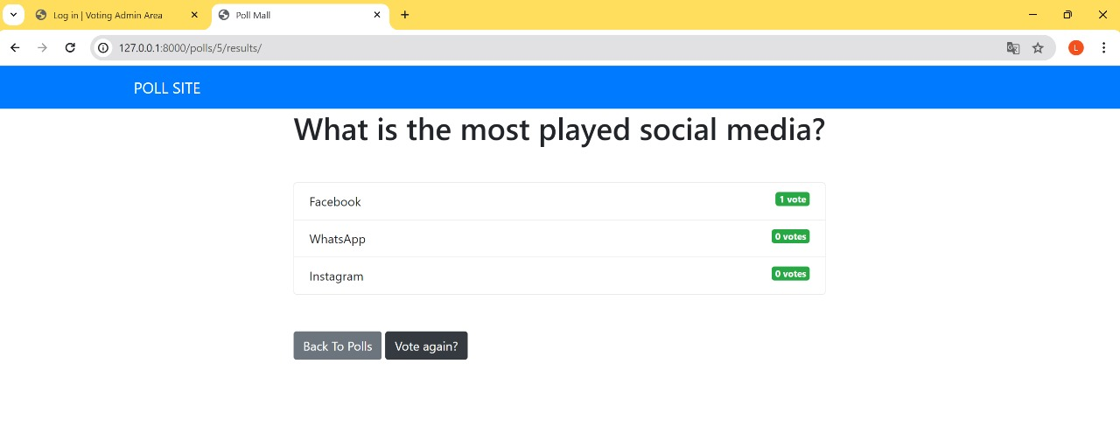

Slide 12
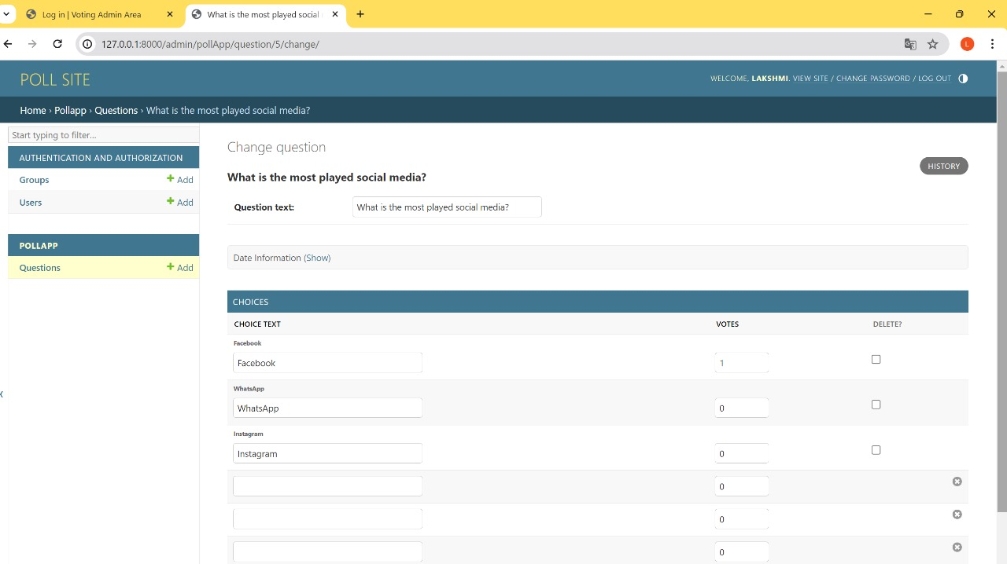

Slide 13
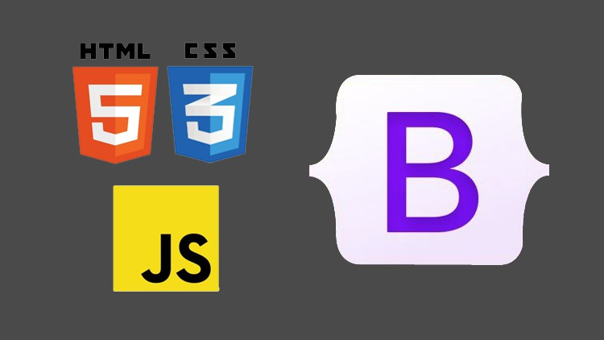
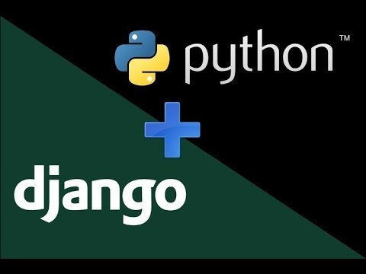
TECHNOLOGY USED
FRONT END BACK END

Slide 14
CONCLUSION
Use the Django command-line tool to create a new project. This will generate the necessary directory structure and configuration files for your application. Create a Django app within your project to handle the functionality specific to the voting application. Define Django models to represent the data entities in your application, such as users, candidates, elections, and votes. Implement views to handle user requests and render appropriate responses. Create templates using HTML, CSS, and possibly Bootstrap to define the user interface and presentation layer of your application. Use Django's template language to integrate dynamic content into your templates. Create an admin panel using Django's built-in admin interface or a custom admin dashboard to manage elections, candidates, and user accounts. By this the capabilities of Django, HTML, CSS, Bootstrap and Python the robust and adoptable online voting application can be build

